Slide 1
Testing of Hypotheses
Session 14
12/04/2021

Slide 2
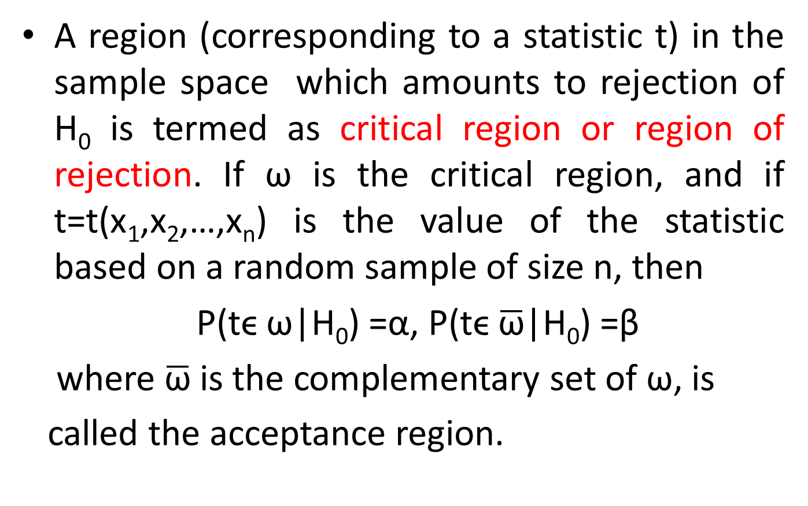
Critical region and Level of significance
A region (corresponding to a statistic t) in the sample space which amounts to rejection of H₀ is termed as critical region or region of rejection. If ω is the critical region, and if t=t(x₁,x₂,…,x_{n}) is the value of the statistic based on a random sample of size n, then
P(tϵ ω|H₀) =α, P(tϵ $\overline{\text{ω}}$|H₀) =β
where $\overline{\text{ω}}$is the complementary set of ω, is
called the acceptance region.

Slide 3
The probability ‘α’ that a random value of the statistic t belongs to the critical region is known as the level of significance. In other words, level of significance is the size of Type I error.
The level of significance usually employed in testing of hypotheses are 5%, 1% and 10%.
The level of significance is always fixed in advance before collecting the sample information.

Slide 4



One tailed tests and Two tailed Tests
One-tailed test: A test of any statistical hypothesis where the alternative hypothesis is one-tailed (right or left) is called one-tailed test.
One tailed tests are always directional, and the H₁ uses either greater than (>) or less than (<) sign.
Two-tailed test: A test of any statistical hypothesis where the alternative hypothesis is two-sided is called two–tailed test. These are directionless.
$$H_{0}: μ=μ_{0 }against H_{1}:μ>μ_{0}$$
$$H_{0}: μ=μ_{0 }against H_{1}:μ<μ_{0}$$
$$H_{0}: μ=μ_{0 }against H_{1}:μ≠μ_{0}$$

Slide 5
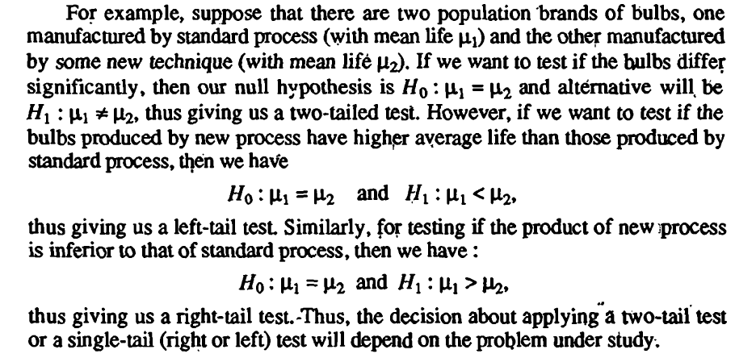
One tailed tests and Two tailed Tests

Slide 6
Three Approaches for Hypothesis Testing
P- Value
Critical Value
Confidence Interval Value
The p-value is the probability, computed using the test statistic, that measures the support (or lack of support) provided by the sample for the null hypothesis.
If the p-value is less than or equal to the level of significance α’ , the value of the test statistic is in the rejection region
Reject H₀ if the p-value ≤ α.

Slide 7
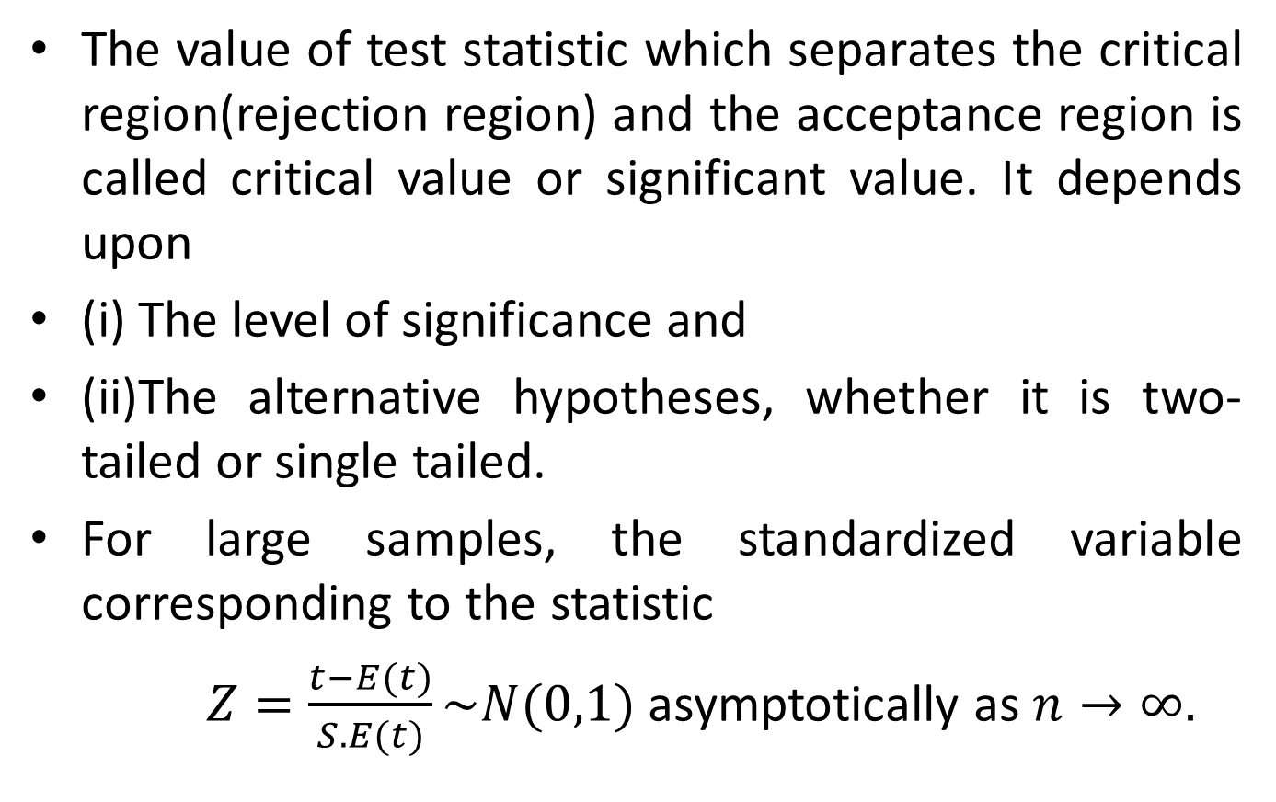
Critical values and Significant values
The value of test statistic which separates the critical region(rejection region) and the acceptance region is called critical value or significant value. It depends upon
(i) The level of significance and
(ii)The alternative hypotheses, whether it is two-tailed or single tailed.
For large samples, the standardized variable corresponding to the statistic
$Z=\frac{t−E(t)}{S.E(t)}\sim N(0,1)$ asymptotically as $n→∞.$

Slide 8
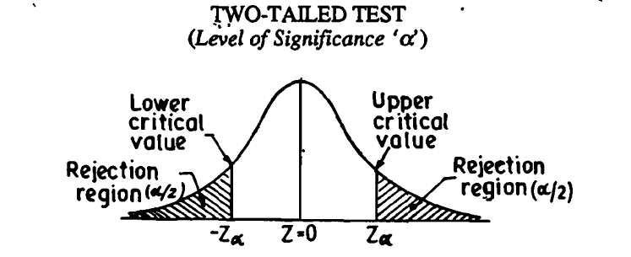
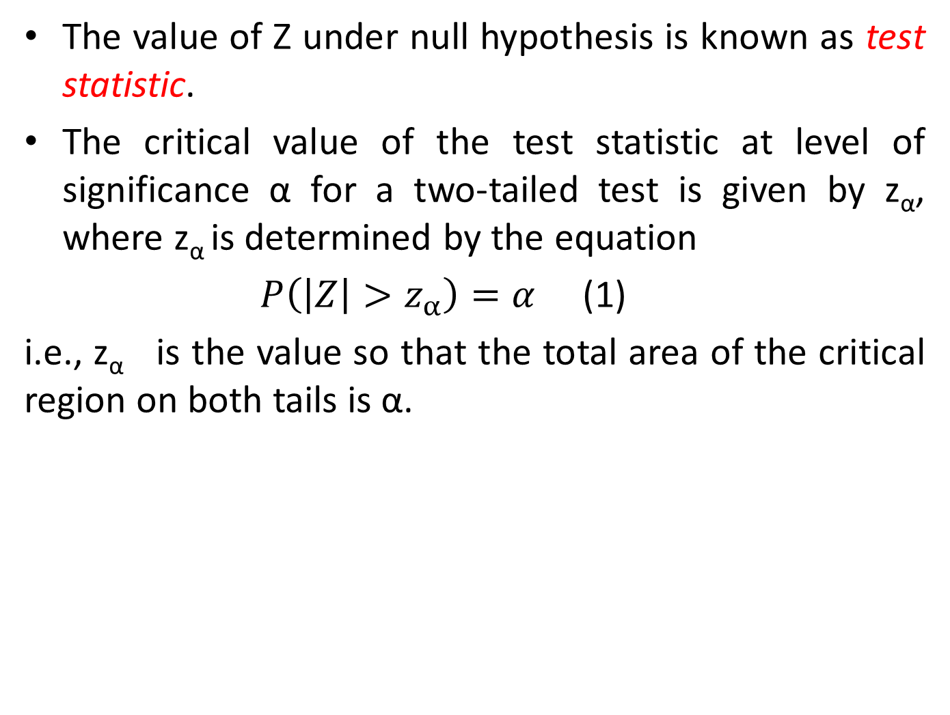
The value of Z under null hypothesis is known as test statistic.
The critical value of the test statistic at level of significance α for a two-tailed test is given by z_{α}, where z_{α} is determined by the equation
$P\left(\left|Z\right|>z_{α}\right)=α$ (1)
i.e., z_{α} is the value so that the total area of the critical region on both tails is α.

Slide 9
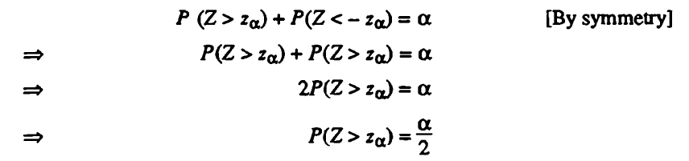

Since normal probability curve is a symmetrical curve from (1), we can write
In other words, the area of each tail is $α/{2.}$

Slide 10
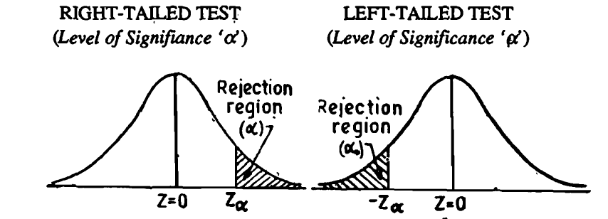
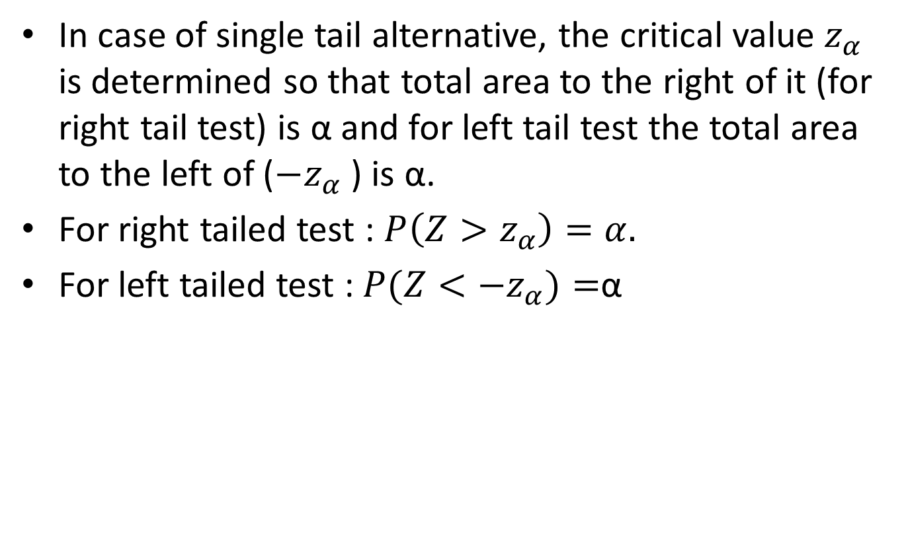
Critical values and Significant values (one tailed test)
In case of single tail alternative, the critical value $z_{α}$ is determined so that total area to the right of it (for right tail test) is α and for left tail test the total area to the left of (${−z}_{α}$ ) is α.
For right tailed test : $P\left(Z>z_{α}\right)=α.$
For left tailed test : $P(Z<−z_{α})=$α

